Slide 1
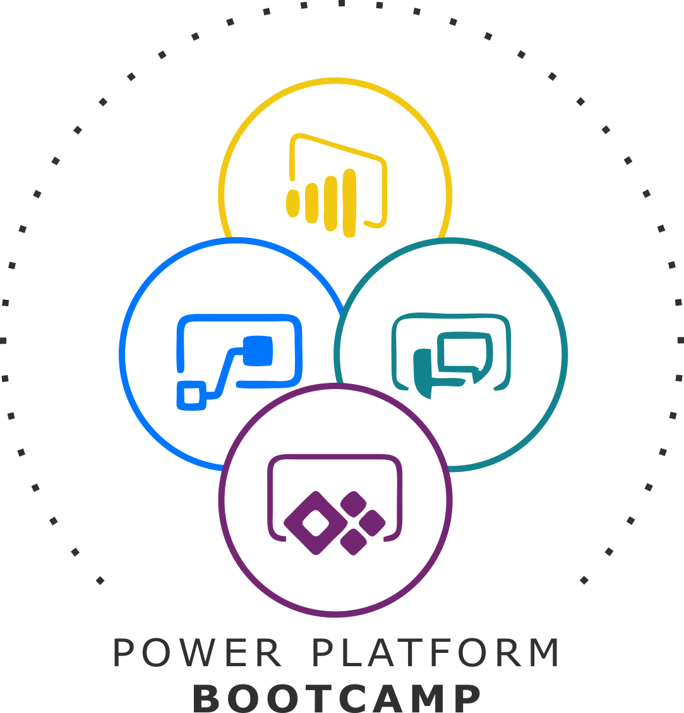


GLOBAL POWER PLATFORM BOOTCAMP
Organized Globally, Held Locally

Slide 2
Digital Transformation-Microsoft Power Platform
Vivek Patel

Slide 3

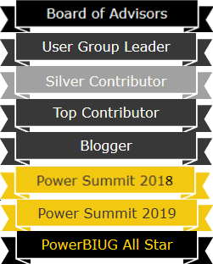






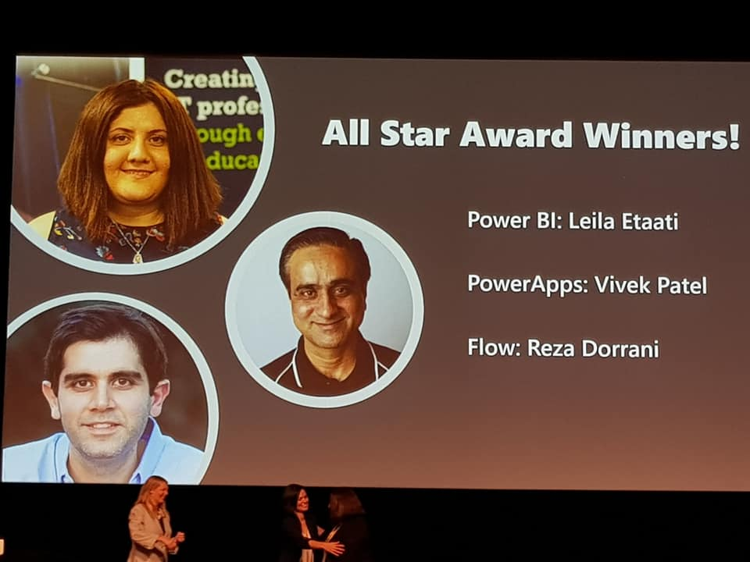


Vivek Patel
Sr. Director North America at Stridely Solution
Founder at Insight2Actions Inc.
Leader:-Toronto Power BI, Power Apps, Flow user group
PowerApps All Star Award Winner
Data Platform MVP
Power BI User Group Board of Advisors (Member)
Member:- Global Power Platform Team
Organizer:- Global Power Platform Bootcamp Toronto -February 15,2020
Organizing Committee/Speaker
Power Platform World Tour 2017(Toronto), 2018(Montreal) and 2019 (Toronto, Calgary, Vancouver)
Collaborate Canada:- 2019 (Toronto, Ottawa, Vancouver)
D365 Saturday:- 2019 (Montreal)
Business Application Summit:- 2017 (Seattle) and 2018(Seattle)
Power Summit North America:-2018(Phoenix ), 2019 (Kissimmee, FL)
Difinity:-2019(Auckland, New Zealand)

Slide 4
Session Agenda
Overview:- Digital Transformation-Microsoft Power Platform

Slide 5



Microsoft Power Platform
The low-code platform that spans Office 365, Azure, Dynamics 365, and standalone applications
Power BI
Business analytics
Power Apps
Application development
Power Automate
Process automation
Power Virtual Agents
Intelligent virtual agents
Data connectors
Common Data Service
AI Builder
Notes:
The Microsoft Power Platform – Empowering millions of people to achieve more
Our vision for the Power Platform started from the recognition that data is increasingly flowing from everything, and a belief that organizations that harness their data – to gain insights then used to drive intelligent business processes – will outperform those that don’t.
We also recognize there aren’t enough programmers, data scientists and tech professionals to go around. So our goal was to build a platform targeting these technology experts and the millions of other frontline workers who see opportunities every day to create something better than the status quo, but who’ve never been empowered to do anything about it.

Slide 6

Integrated low code platform
Automate your app
Drive business process with an app
CDS
Automate
Act
Automate response to metrics
Act on data during analysis
Analyze data to find places to automate
Analyze the data exhaust from apps
Analyze
Notes:
Our guiding vision was a framework we called the “Triple-A Loop” – a closed-loop system allowing users to gain insights from data (Analyze) used to drive intelligent business processes via apps they build (Act) and processes they automate (Automate).
The Microsoft Power Platform implements this vision via three cloud-based services: Power BI, PowerApps and Flow.
PowerApps is our low code application development platform – allowing anyone to build web and mobile applications without writing code. The natural connection between Power BI and PowerApps makes it effortless to put insights in the hands of maintenance workers, teachers, miners and others on the frontline, in tailored and often task-specific applications that supercharge their productivity and make their work perhaps a little less tedious.
Like Power BI, PowerApps connects to hundreds of business systems and databases, making it easy to connect workers with the existing processes and data that makes the business tick. And all the data captured in PowerApps can make its way right back to those very systems for further analysis in Power BI creating a closed-loop process for continuous improvement.
Additionally, PowerApps comes with a built-in, fully-managed, enterprise-grade datastore called the Common Data Service (CDS) for those applications that generate data not destined for a legacy system – and Power BI and Flow have deep connections to CDS making it that much easier to get even more value from data stored there.
Extending the Power Platform via connectors to other Microsoft offerings allow our clients to leverage those investments and create productivity faster.
With Office 365, we offer a complete intelligent solution that empowers your employees to creative, collaborate and work together with Office 365, Skype, Teams
With Dynamics 365, our intelligent business applications, we offer a complete set of solutions across Marketing, Sales, Commerce, Service, Finance, Operations and Talent.
With Microsoft Azure we are delivering the most productive, hybrid, intelligent, and trusted cloud to run your business.
Azure is offered in 54 regions, more than any cloud provider;
Offers 70+ compliance industries, the largest portfolio in the industry;
95% of Fortune 500 companies run on Azure

Slide 7








Azure + Power Platform = Build apps faster than ever before
Power Platform
Every Developer
Power BI
Power Apps
Power Automate
Power Virtual Agents
Azure services
Pro Developer
Azure
DevOps
API Management
Azure Functions
AKS
Cognitive Services
Azure Data Services
SQL Azure
Cosmos DB
Azure Data Lake
SQL Data Warehouse
Visual
Studio
VS
Code
Notes:
Starting with your data and middle tier foundation, developers now have unprecedented capability to create apps and experiences faster than ever before with the Power Platform.
Enrich and consolidate your data foundation with Azure and Common Data Service
Leverage Azure Services to extend the Power Platform
Every developer can leverage the Power Platform to expedite app delivery and eliminate the backlog

Slide 8
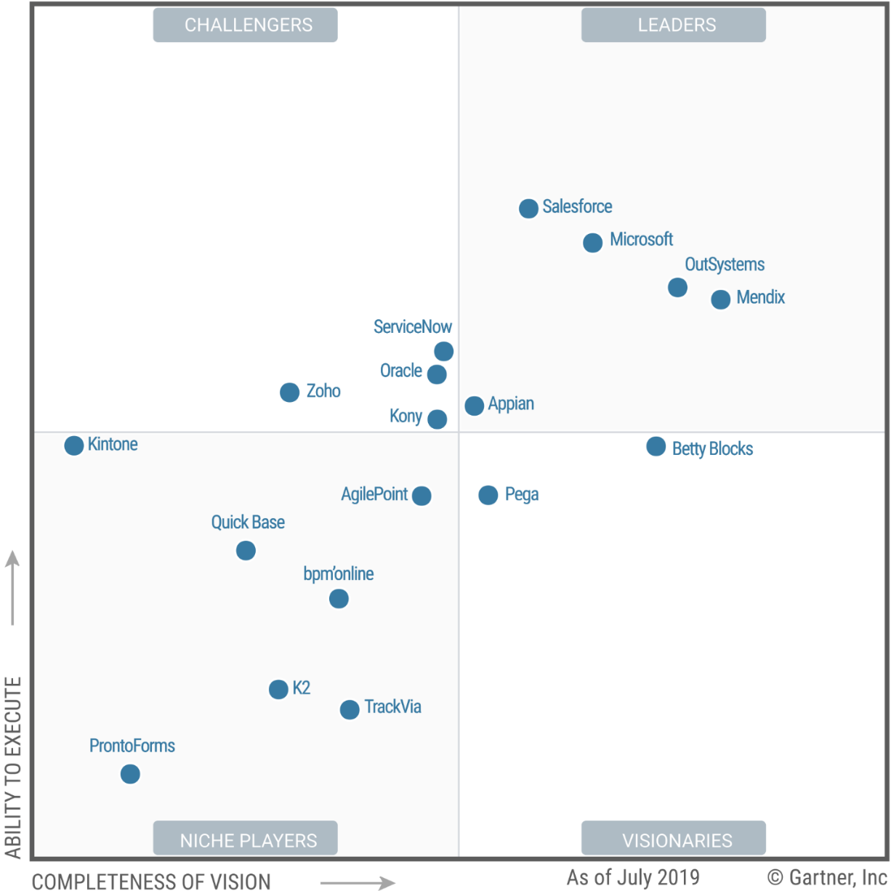

August 2019
A Leader in
Enterprise Low-Code Application Platforms*
https://www.gartner.com/doc/reprints?id=1-1OC4M37Y&ct=190730&st=sb
Notes:
Story – low code –
#Gartner 65% of application development activities in the enterprise will be in the low-code category by 2024
Demand for mobile apps is growing 5x faster than IT departments can deliver.
New quadrant – the participants in the race identified.
Rumour – Amazon to acquire a low code vendor.

Slide 9
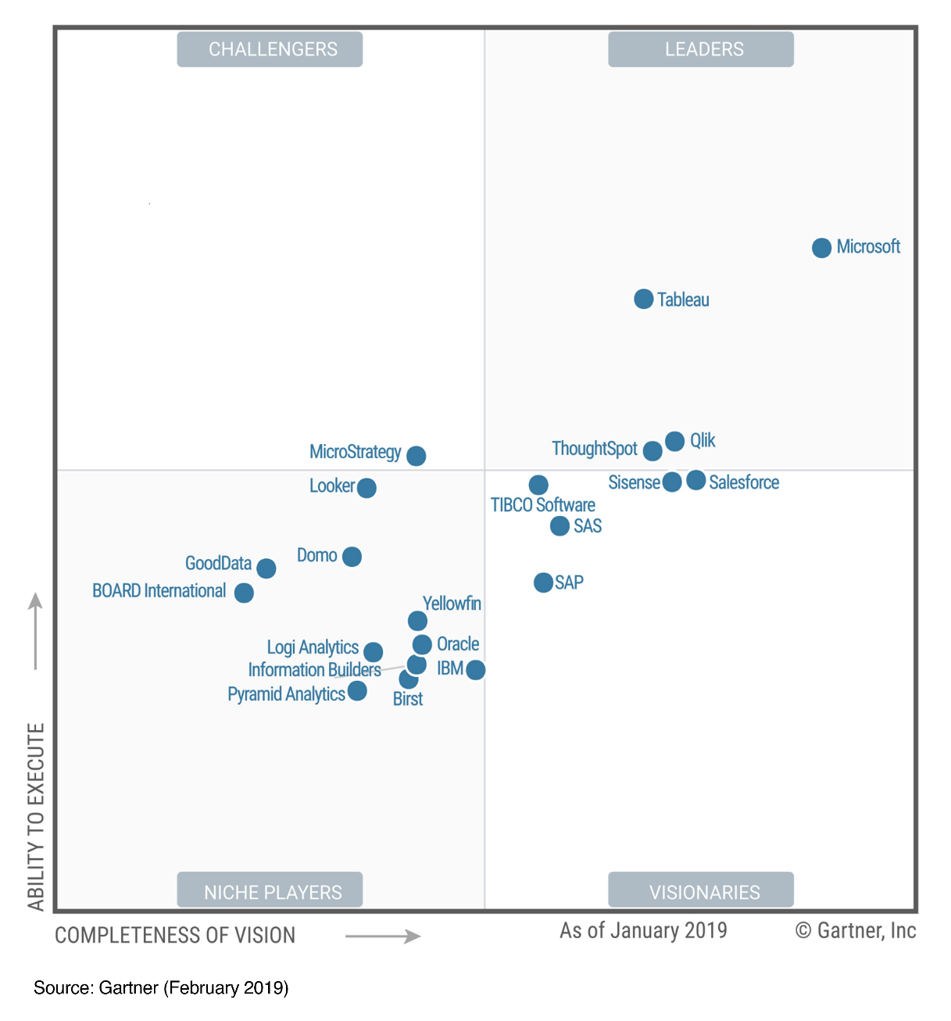
February 2019
A Leader in
Analytics & BI Platforms*

Slide 10
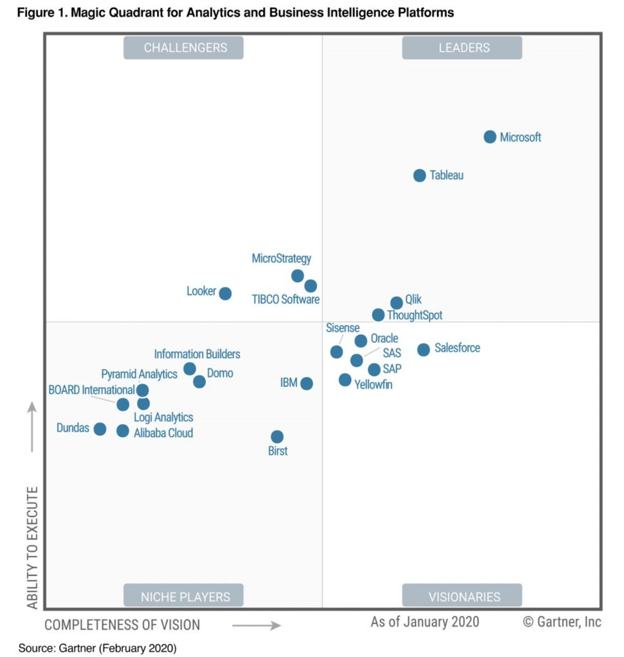
February 2020
A Leader in
Analytics & BI Platforms*

Slide 11

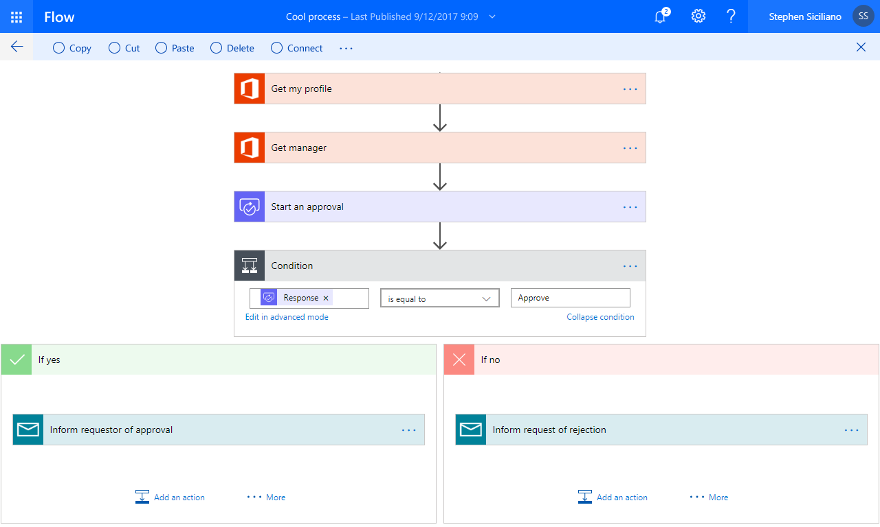
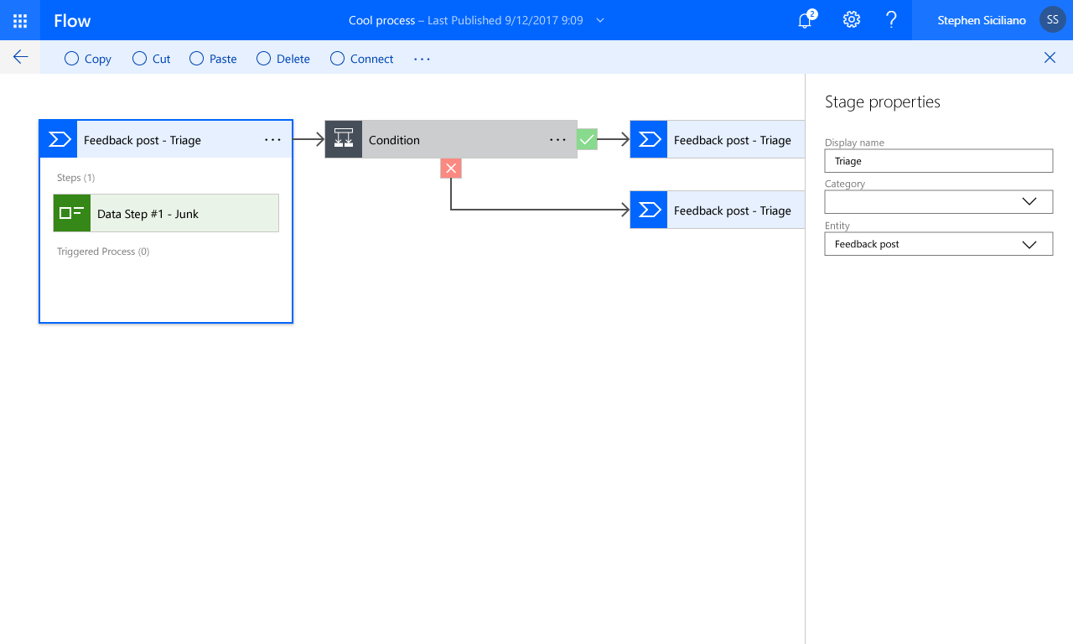

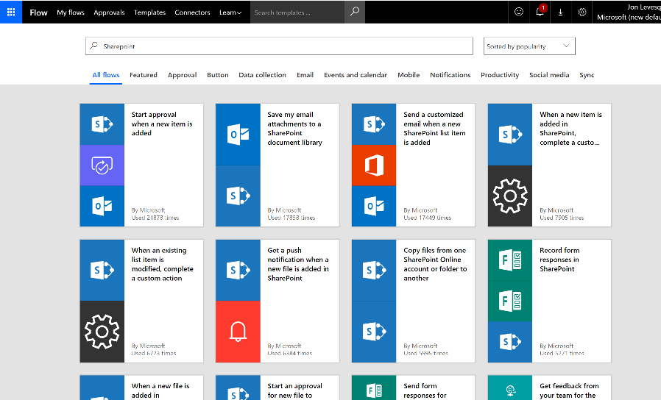

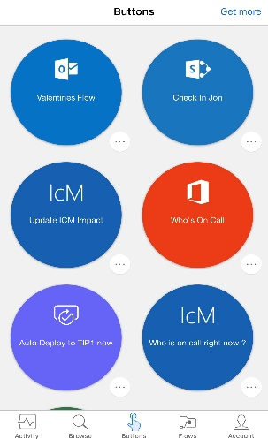
Power Automate

Slide 12
Microsoft Power Automate A low-code approach to intelligent automation
Model business processes and automate workflows across your apps and services.
Connect to all your data with 275+ pre-built connectors and custom connectors.
Strong enterprise governance & security.
Pro-dev extensibility with Azure and custom logic.

Slide 13

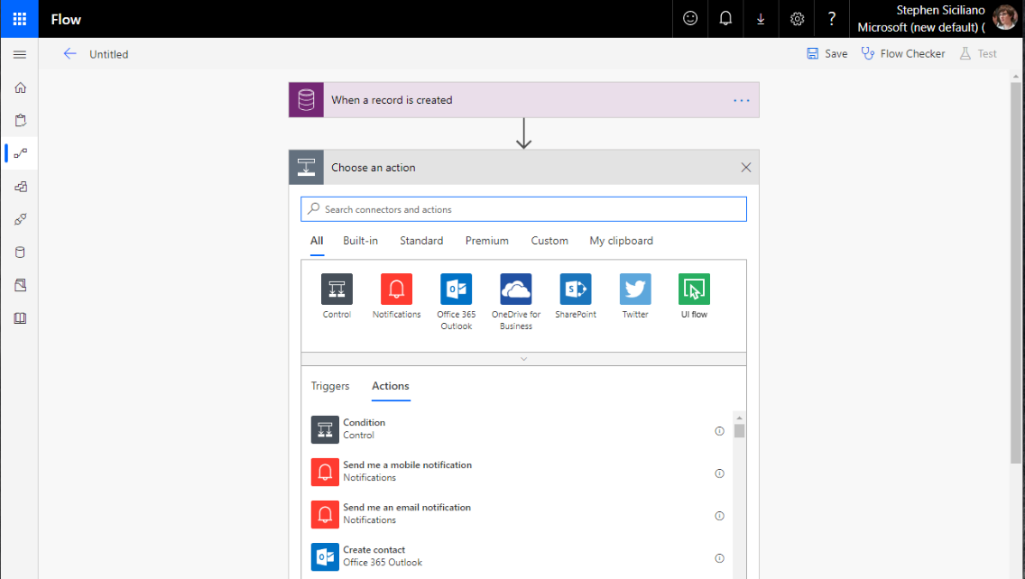
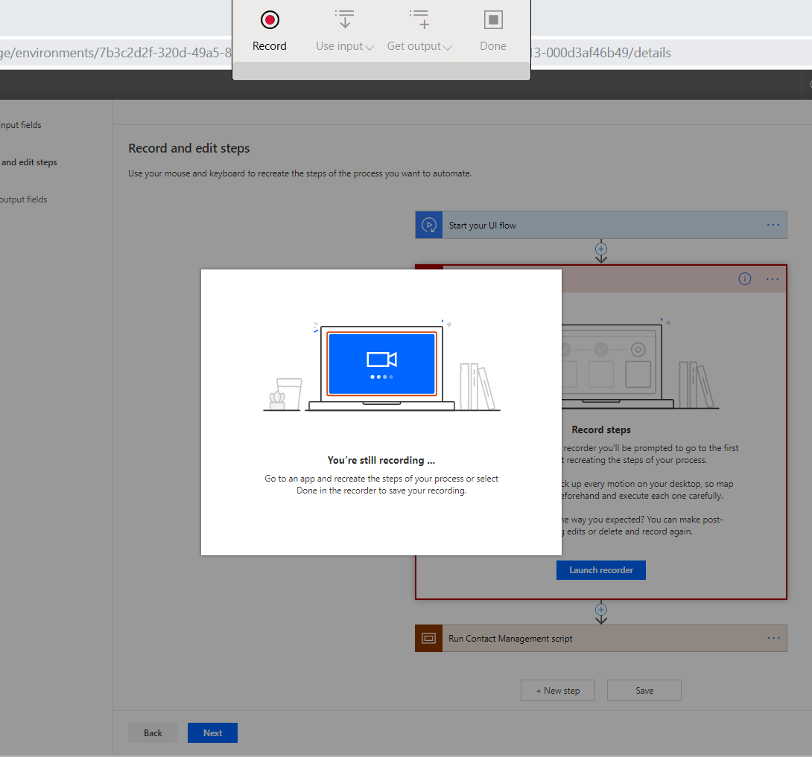
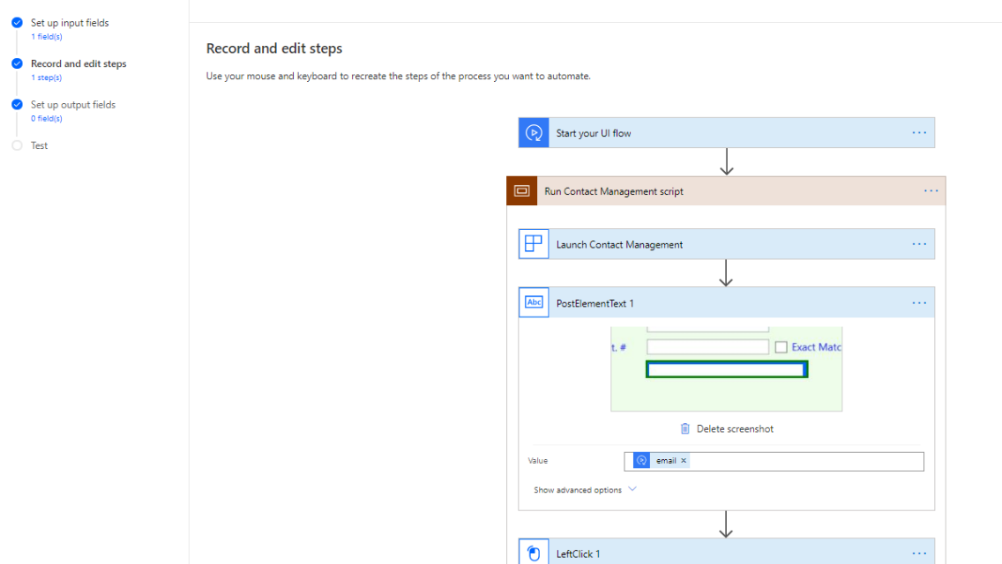
Power Automate adding Robotic Process Automation UI flow Public Preview
UI Flows connector
Record steps
Easy to edit
Notes:
RPA feature available with new UI flows connector
Easily record the UI
Edit flow as needed in the Power Automate portal

Slide 14
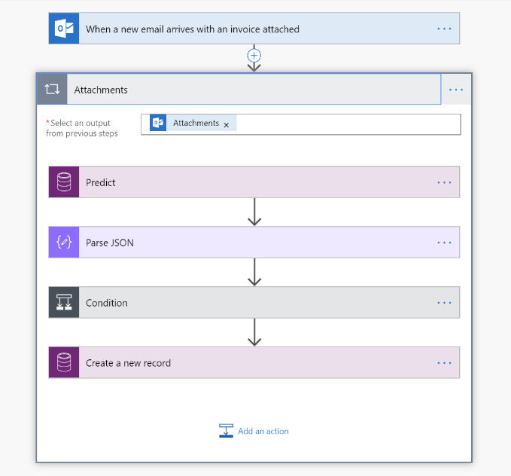
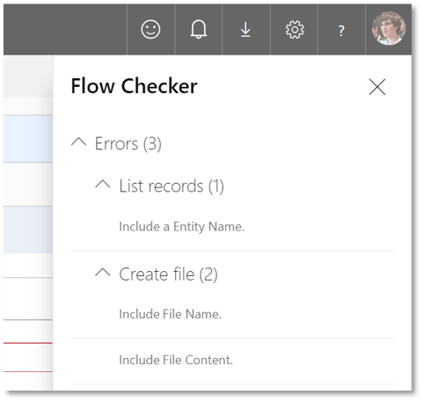
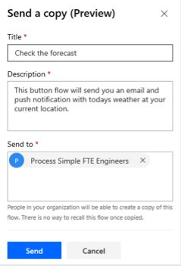
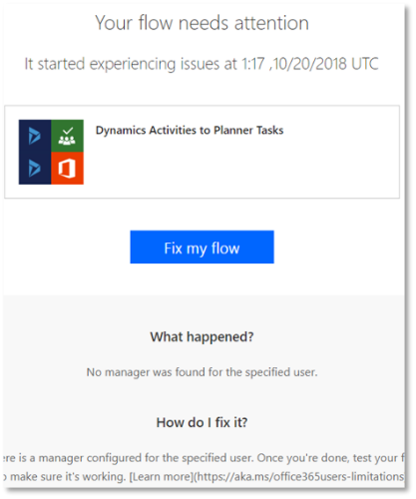
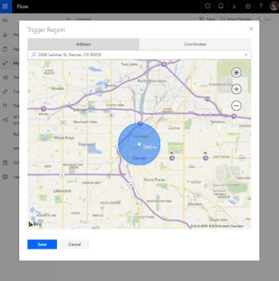

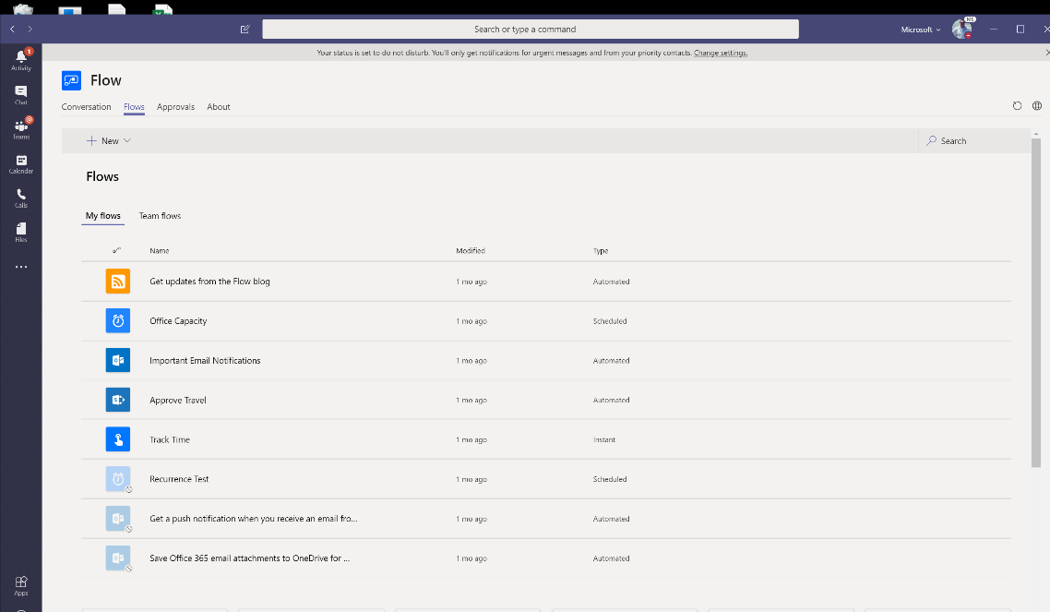
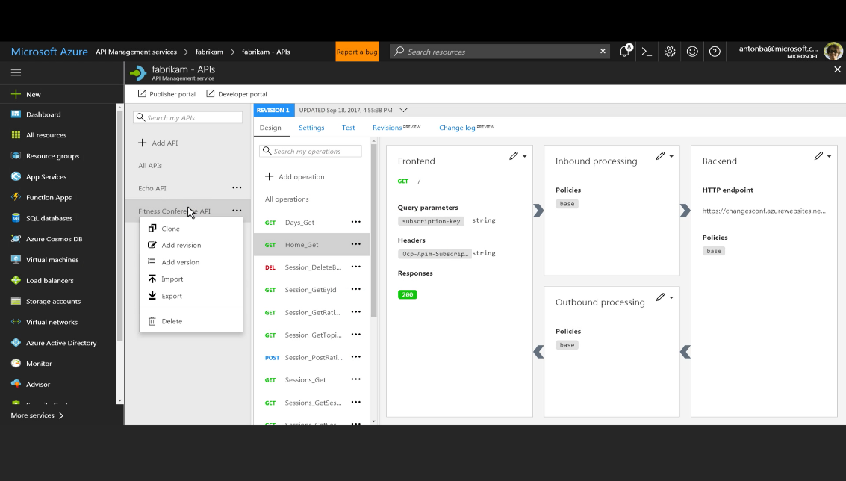
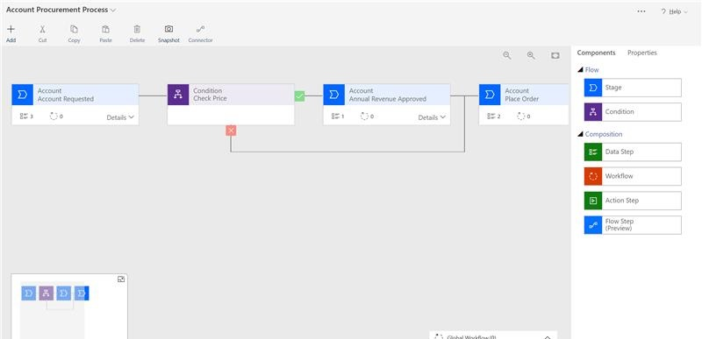
Power Automate – new capability highlights
Intelligent flows with AI Builder
Flow Checker repair tips
Authoring improvements
Automate directly from Teams
Integrated with Azure API Manager
Create business process flows

Slide 15

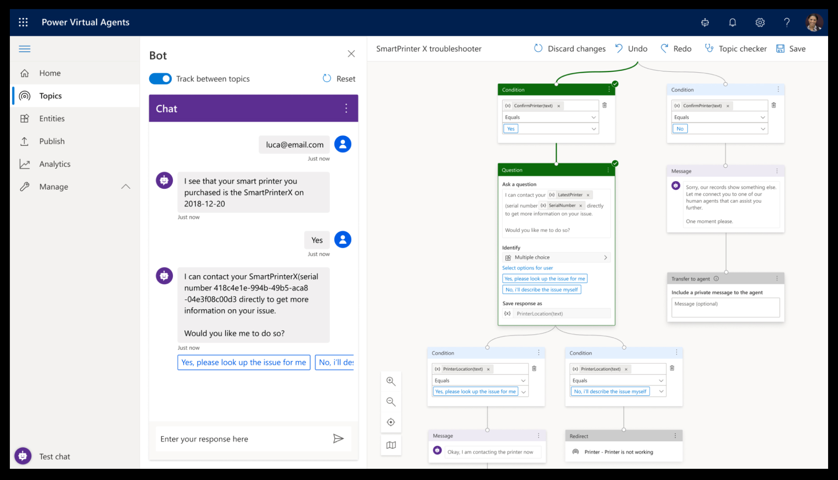

Power Virtual Agents

Slide 16
Microsoft Power Virtual Agents
Engage with your customers and employees conversationally. Resolve routine issues easily, freeing up staff to focus on complex matters.
Empower your subject matter experts. Easily create powerful bots using a guided, no-code graphical interface and AI-driven suggestions.
Less talk more action. Leverage all the Power Platform connectors, or call APIs and custom processes using Power Automate.
Easily extend your bots. Add even more complex capabilities using Microsoft Bot Framework.

Slide 17
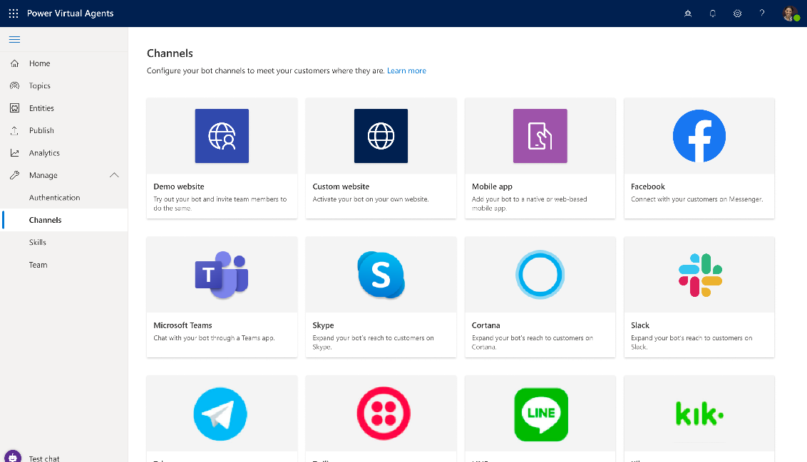
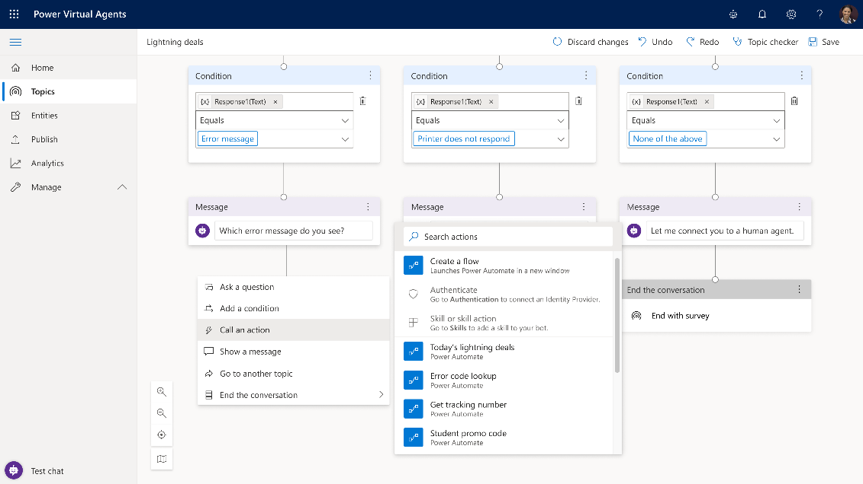
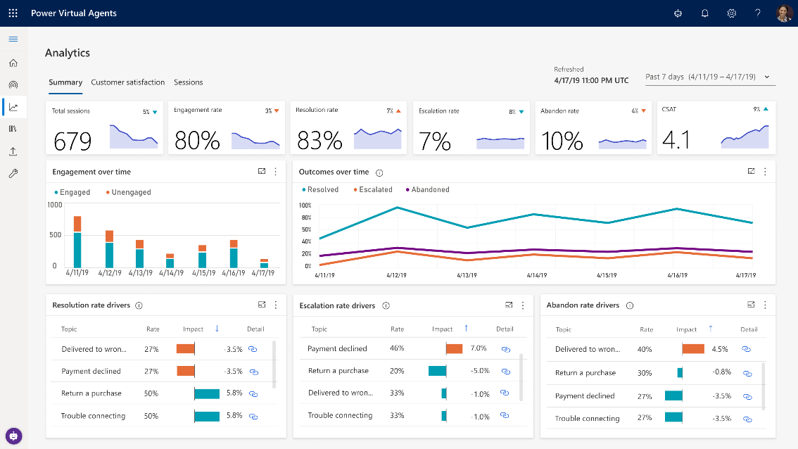
Power Virtual Agents
Integrate your backend systems and automate actions
Easily improve your bots over time
Embed your bots everywhere
Notes:
Embed your bots with a few clicks to the channel of your choice, including Web, Facebook, Team, and many more
Easily integrate with your backend systems using the hundreds of connectors that come with the Power Platform, or call custom APIs and workflows with Power Automate. And the full power of the Microsoft Bot Framework is only a few clicks away.
Get easy access to insights on which topics are performing well, which need improvement – and what to build next

Slide 18
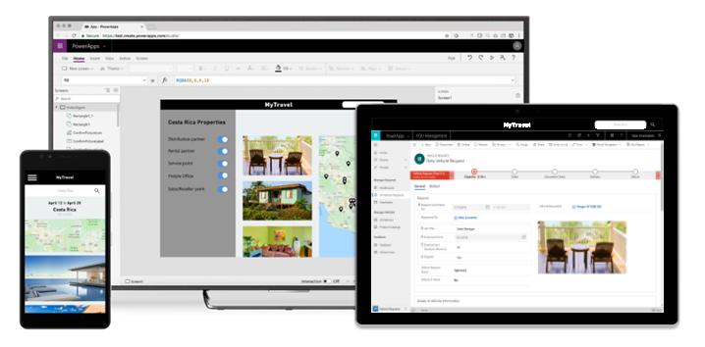
Power Apps
Notes:
And as a quick refresher – PowerApps is all about providing a low-code way to rapidly build apps for mobile and the web. We make it easy to connect to your existing data, with over 250 pre-built connectors, as well as the built-in Common Data Service. All of this speed does not compromise on power, though- PowerApps is all about strong enterprise governance and security, and has a bunch of professional developer hooks.
Easily build apps with a full featured low-code / no-code platform
Connect to all your data with pre-built connectors, custom connectors
Put your data to work with the Common Data Service for Apps
Streamlined Office 365, Azure, Dynamics 365, Power BI, Microsoft Flow integration
Strong enterprise governance & security
Pro-dev extensibility

Slide 19
Microsoft Power Apps A low-code approach to building intelligent apps
Build standalone web and mobile apps, or customize existing apps in Office 365 and Dynamics 365.
Connect to all your data with 275+ pre-built connectors and custom connectors.
Add AI and intelligence with ease through built-in cognitive services.
Provide IT guardrails with enterprise-grade governance and security controls.
Pro developer extensibility enables a “no limits” platform that spans business users to professional developers.
Notes:
And as a quick refresher – PowerApps is all about providing a low-code way to rapidly build apps for mobile and the web. We make it easy to connect to your existing data, with over 250 pre-built connectors, as well as the built-in Common Data Service. All of this speed does not compromise on power, though- PowerApps is all about strong enterprise governance and security, and has a bunch of professional developer hooks.
Easily build apps with a full featured low-code / no-code platform
Connect to all your data with pre-built connectors, custom connectors
Put your data to work with the Common Data Service for Apps
Streamlined Office 365, Azure, Dynamics 365, Power BI, Microsoft Flow integration
Strong enterprise governance & security
Pro-dev extensibility

Slide 20
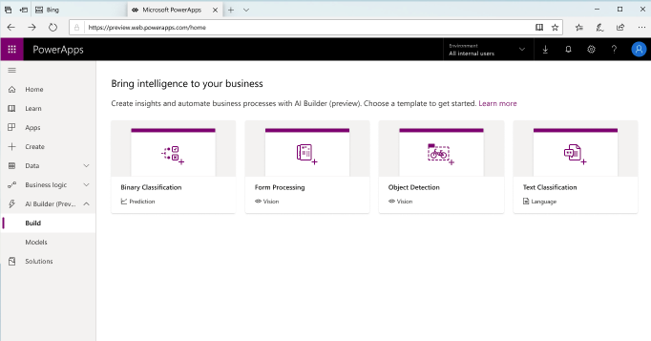
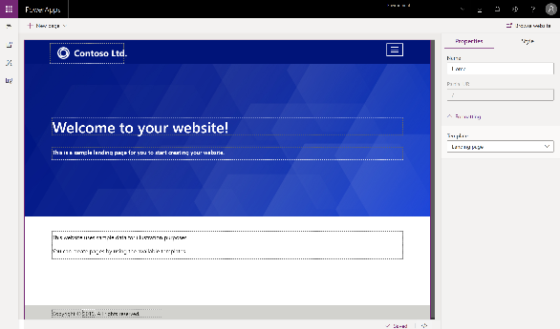
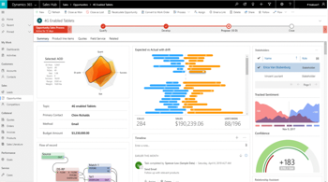
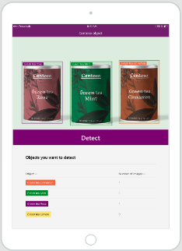


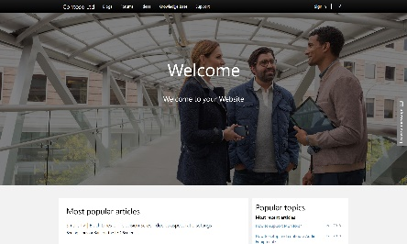

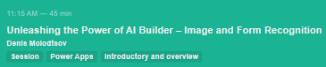
Power Apps – areas of investment
AI Builder
Portals
Enabling EVERY developer
Notes:
Four types of AI models out of the box to make your applications intelligent
Use prebuilt templates or create your own websites for internal or external users
From Custom Components to build tools
and CI/CD integration
Low code AI solutions for PowerApps and the Common Data Service leveraging the power of Microsoft AI
Low code solution for multilingual, responsive websites for internal and external users
Reusable, responsive custom components from 3rd party developers using TS and JS

Slide 21


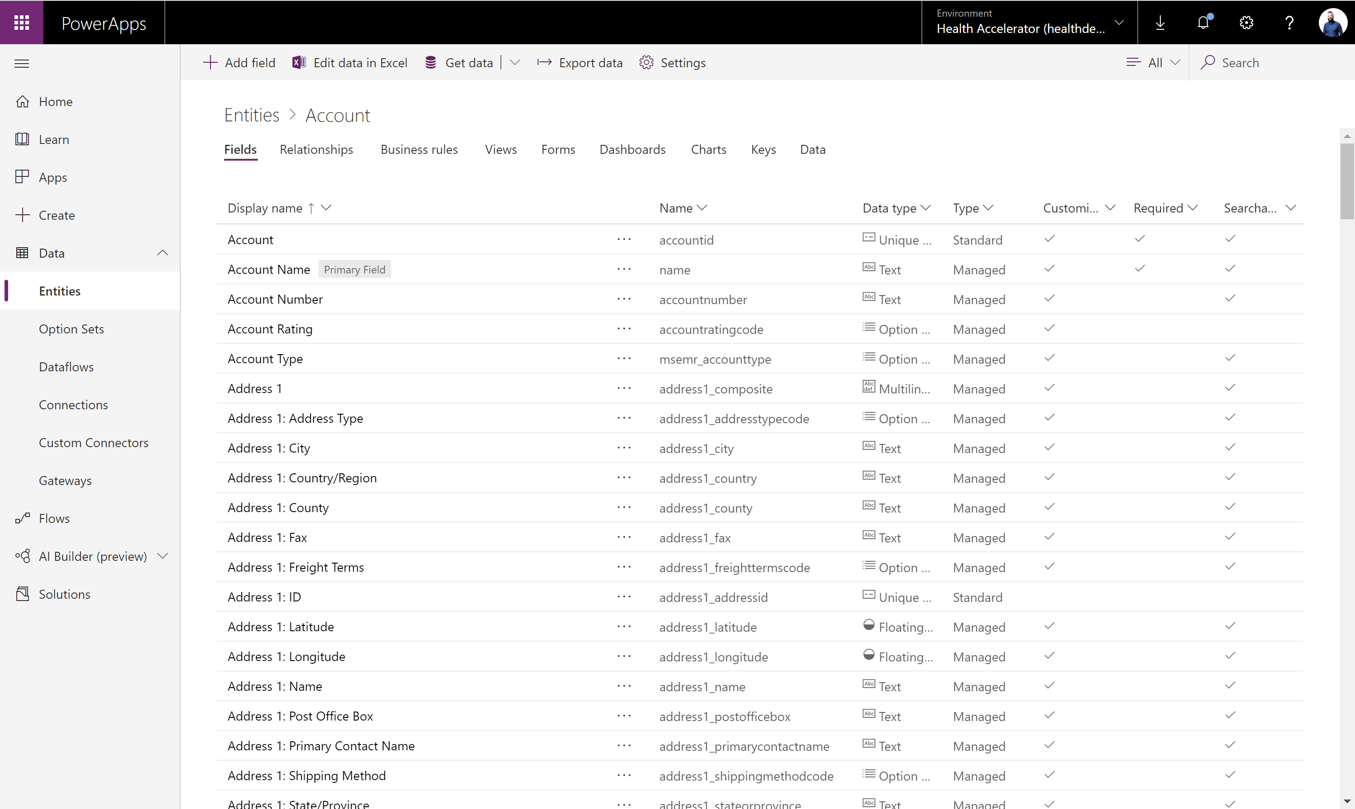
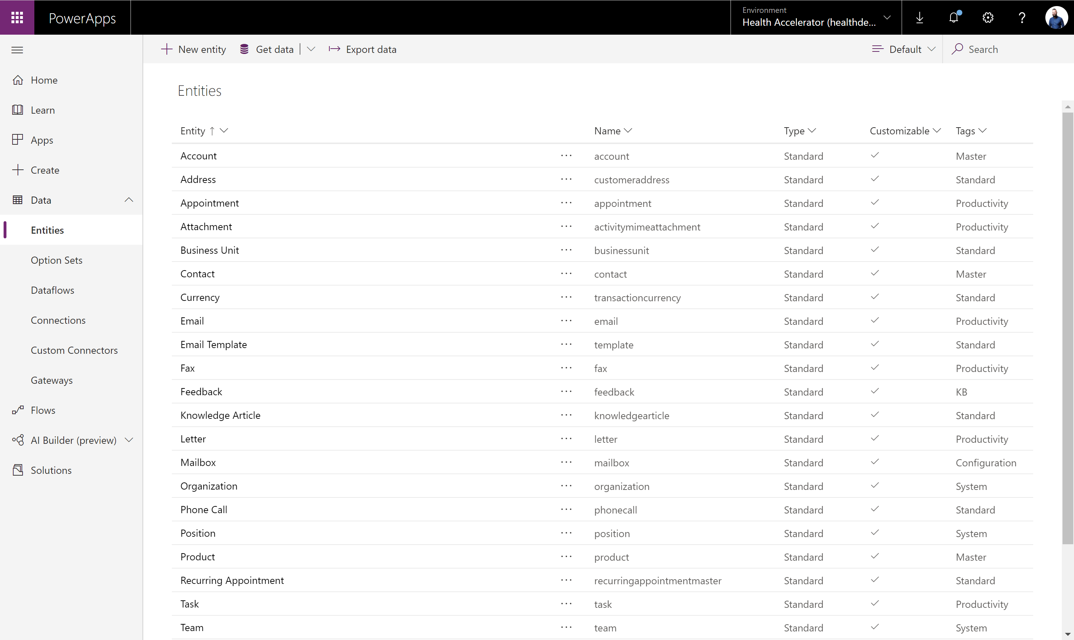
Low-code backend with the Common Data Service
Jumpstart apps using an extensible data model with business logic, security and integration built in.
Enable AI through built-in cognitive services powered by AI Builder and Azure.
Extend data and processes to external and anonymous users with Power Apps portals.
Support all your data: relational data, file and blob storage, logs and search indexing.
Effortless Dynamics 365, Office 365 and Azure integration as well as powerful integration capabilities.

Slide 22
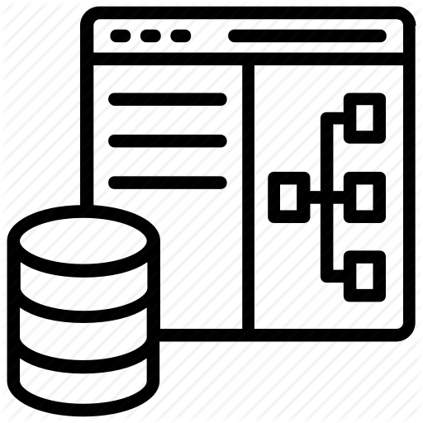
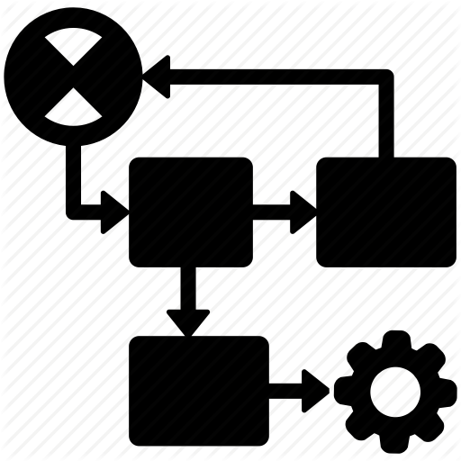




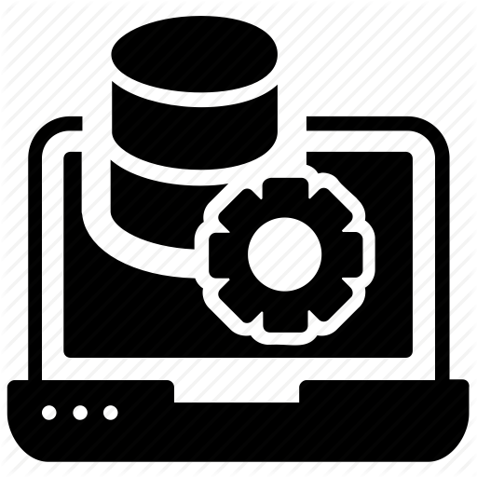

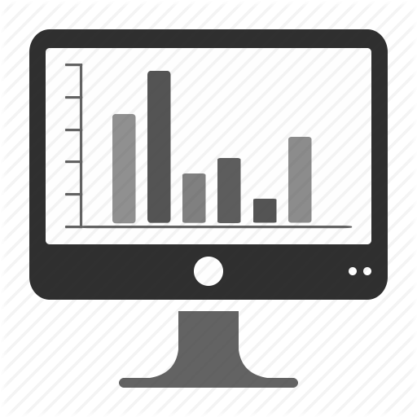


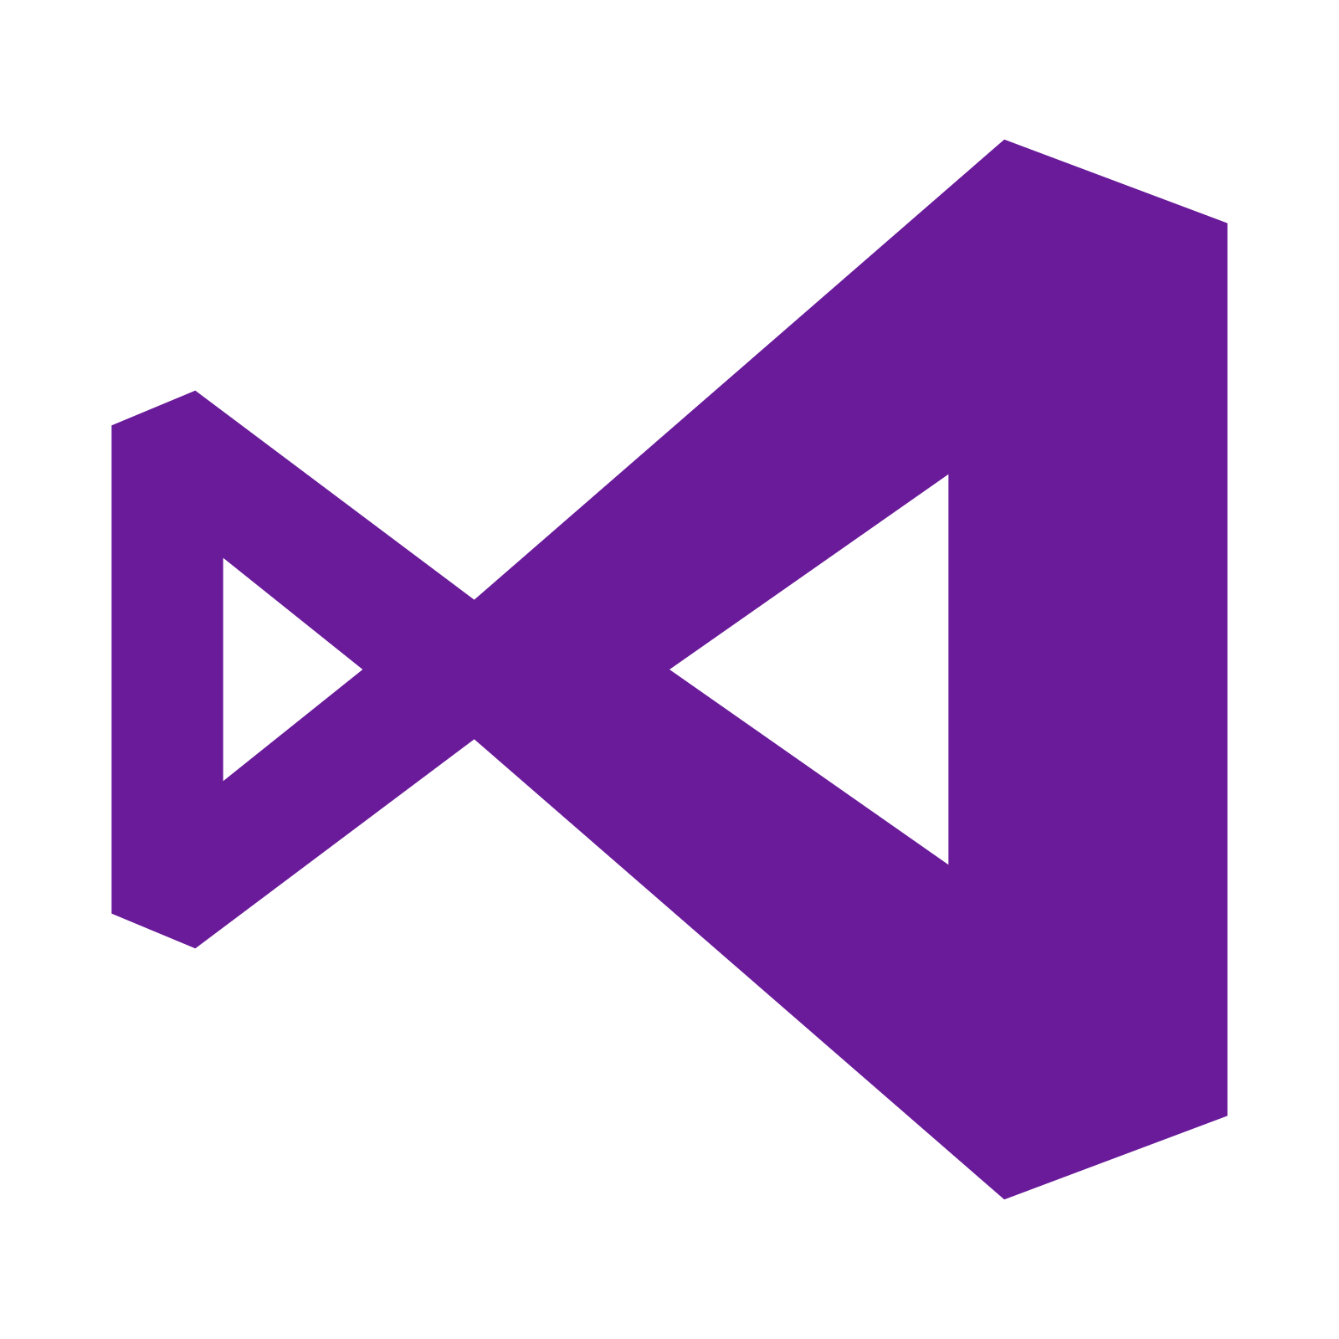








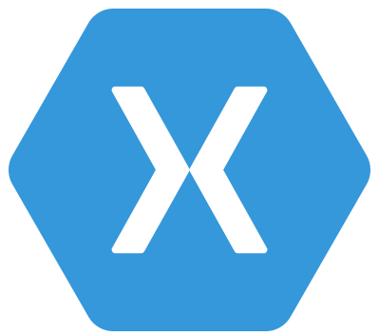

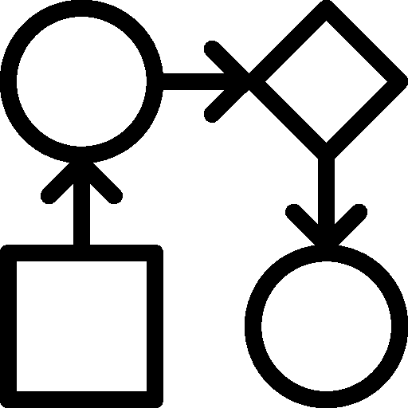
Common Data Service: What’s in the box
Integration
Storage
Relational
databases
Eventing
Data
Catalog
and discovery
Files and
blobs
Logic
Log files
Webhooks
Jobs
Modelling
Security
Reporting
Semi-structured
data
Business
Rules
API
Calculated &
Rollup fields
Authentication
Duplicate
Detection
Data
validation
Search and
Find data
Authorization
Plugins
Data export
Common Data
Model
Auditing
Workflows
Data lake
Notes:
If you aren’t familiar with the common data service, let’s take a look at what’s inside.
The Common Data Service is API first – everything you do in CDS creates an API.
CLICK
These are the same APIs are consumed by PowerApps, Power Automate, AI Builder, and PowerBI.
CLICK
But, these APIs can also be consumed via custom applications built in Visual Studio or Xamarin.
CLICK
Immediately below the API, we have a rich security layer – ensuring that the right people can see the right data, and auditing all access along the way.
CLICK
From there we get to our logic layer, where you can implement custom business logic. Because this logic is below the API, this ensures consistent business logic across ALL applications accessing your data.
CLICK
Then we get to the heart of CDS – our data tier. This allows you to define the structure of your complex business data, without writing code.
CLICK
And, behind the scenes, we’re putting your data in the right place, using the optimal storage services provided by Azure. This allows us to seamlessly support practically any time of data – from relational data to log data to file data to search indexes to data stored in Azure Data Lake.
CLICK
Finally, no deployment of CDS lives alone – it must be integrated with other systems. We provide many ways to integrate CDS with external systems – from eventing to WebHooks to Data Export.

Slide 23
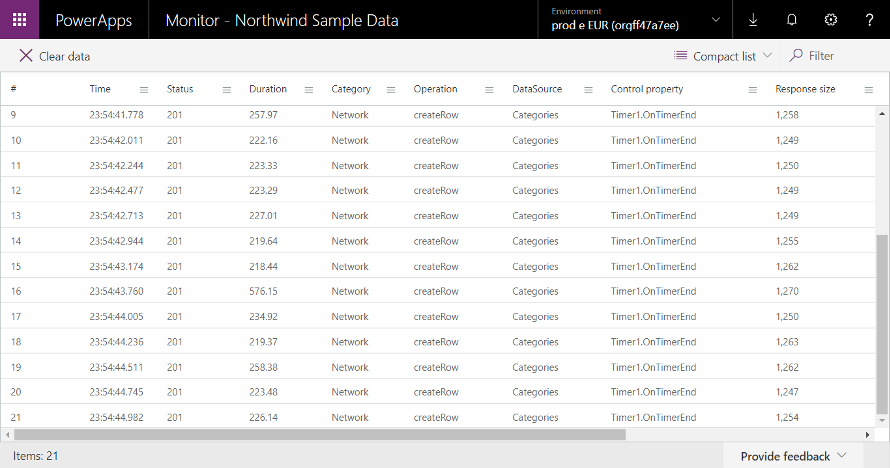
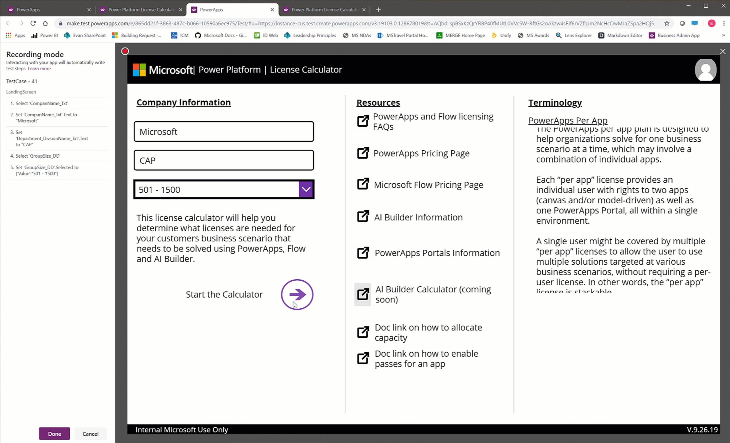
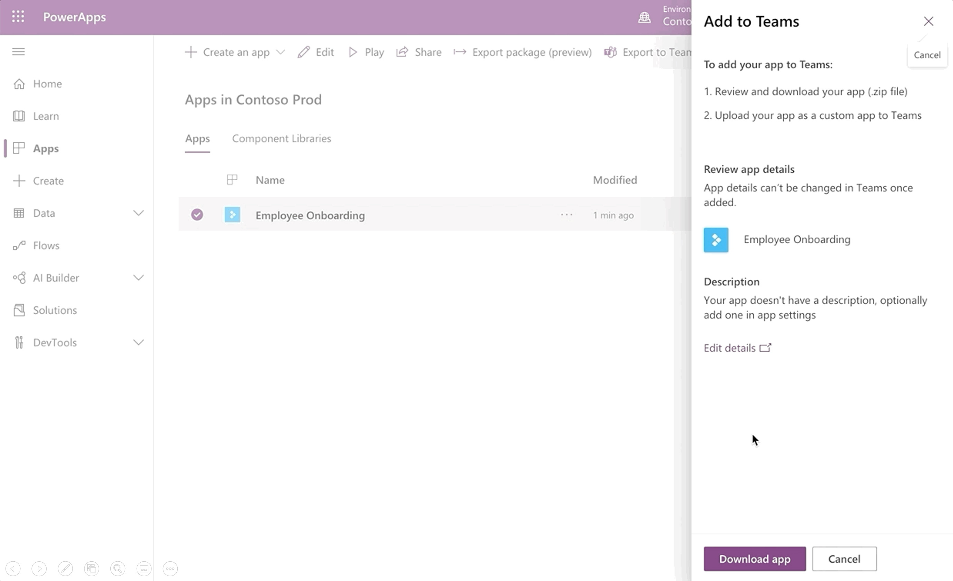
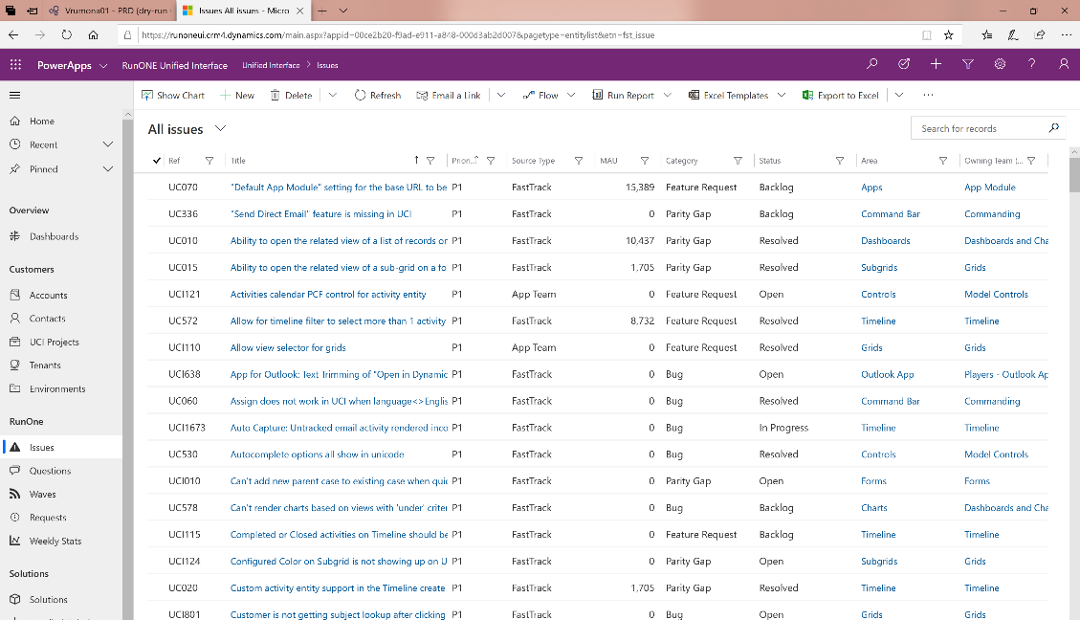
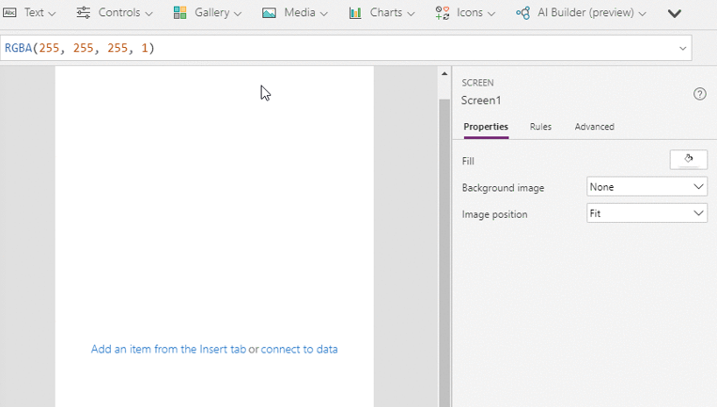
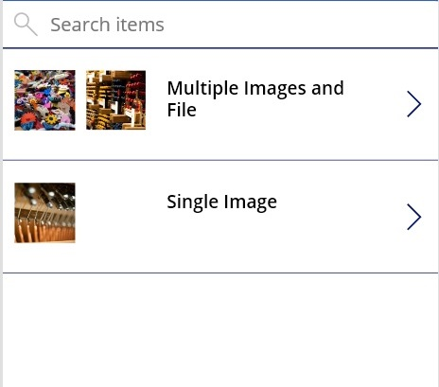
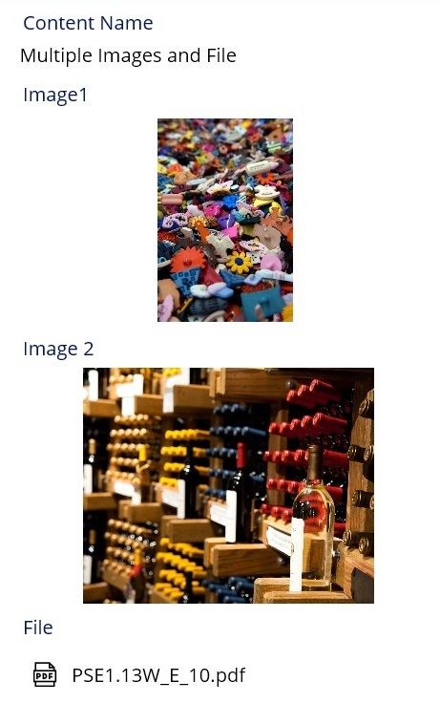

Power Apps – new capability highlights
Power Apps Monitor
Power Apps Test Framework
Export existing apps to Microsoft Teams
Streamlined model-driven app experiences
Improved Canvas connectivity with Views
Native support for images and files across app types

Slide 24
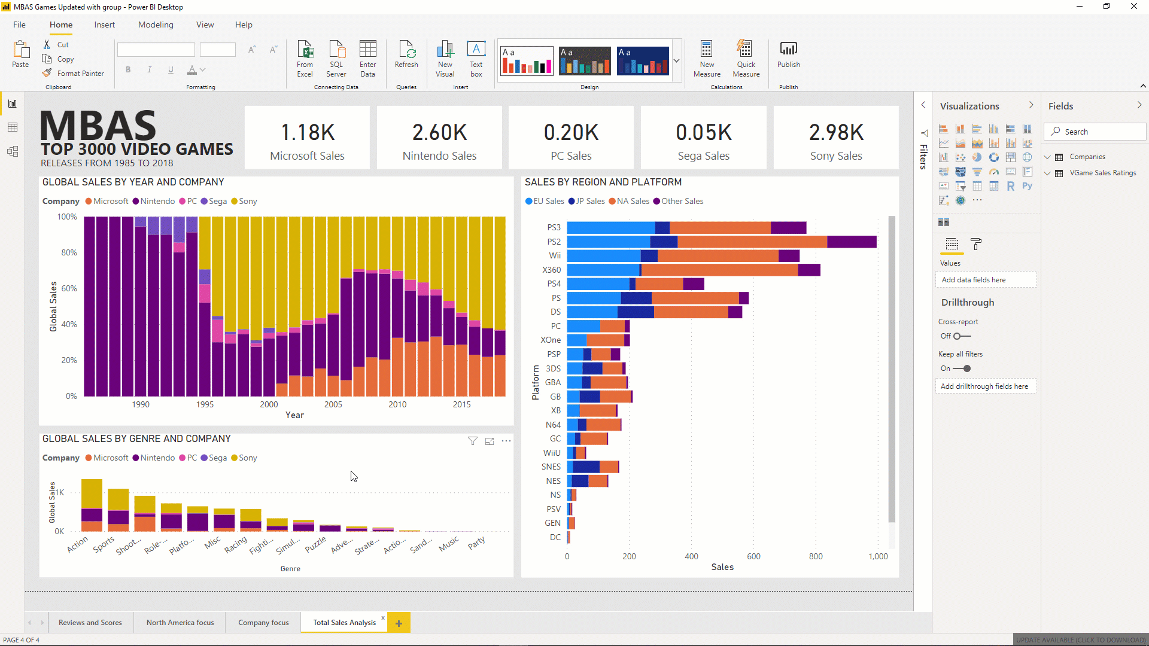
Power BI
Notes:
And as a quick refresher – PowerApps is all about providing a low-code way to rapidly build apps for mobile and the web. We make it easy to connect to your existing data, with over 250 pre-built connectors, as well as the built-in Common Data Service. All of this speed does not compromise on power, though- PowerApps is all about strong enterprise governance and security, and has a bunch of professional developer hooks.
Easily build apps with a full featured low-code / no-code platform
Connect to all your data with pre-built connectors, custom connectors
Put your data to work with the Common Data Service for Apps
Streamlined Office 365, Azure, Dynamics 365, Power BI, Microsoft Flow integration
Strong enterprise governance & security
Pro-dev extensibility

Slide 25
Power BI: experience your data Any data, any way, anywhere
Web
Mobile
Excel
Cloud data
Power BI
Embedded
HoloLens
On-premises data
“……”
Notes:
Our objective with Power BI is to make it really easy for you to experience your data.
Connect to any data source, on premise or in the cloud and
deliver compelling insights to every employee in your organization
So whether your employees are in the office, or on the road, whether they are in front of their PC, or walking the factory floor,
they have information at their fingertips.
But why does it matter? What is Power BI really about?

Slide 26

Data Culture

Slide 27
Data Culture
#1
AI infused experiences with the familiarity of Office
Amazing
Data Exploration
Experiences
Notes:
Momentum numbers: data points that support this
Enterprise growth (600%)
95% Fortune 500 use PBI
Infra will become Data Platform

Slide 28
Data Culture
#2
Meet the most demanding enterprise needs
Amazing
Data Exploration
Experiences
Modern Enterprise BI
Notes:
Momentum numbers: data points that support this
Enterprise growth (600%)
95% Fortune 500 use PBI
Infra will become Data Platform

Slide 29
Data Culture
Productivity
#3
BI woven into the fabric of the organization
Amazing
Data Exploration
Experiences
Trust
Action
Modern Enterprise BI
Data Stack
Notes:
Momentum numbers: data points that support this
Enterprise growth (600%)
95% Fortune 500 use PBI
Infra will become Data Platform

Slide 30
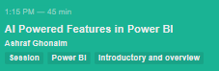











AI Powered Analytics
Data Scientists
Analysts
End users
Extend with Azure ML
R Integration
Create ML models
Sentiment Analysis
AI Visualizations
Integrate into reports
Python Integration
Explore predictions
Key Phrase Extraction
Natural Language

Slide 31




Data Exploration – New capability highlights
Power BI
Cognitive Services in Power BI Desktop
Q&A 2.0
Decomposition Tree

Slide 32
Data Culture
#2
Meet the most demanding enterprise needs
Amazing
Data Exploration
Experiences
Modern Enterprise BI
Notes:
Momentum numbers: data points that support this
Enterprise growth (600%)
95% Fortune 500 use PBI
Infra will become Data Platform

Slide 33


Modern Enterprise BI
Machine
Learning
Enterprise
Semantic
Models
#2
Meet the most demanding enterprise needs
Dataflows
(ETL)
Enterprise
Reports
Amazing
Data Exploration
Experiences
Real Time
Streams
Embedded
Analytics
Lineage &
Impact Analysis
Application
Lifecycle
Management
Modern Enterprise BI
Notes:
Momentum numbers: data points that support this
Enterprise growth (600%)
95% Fortune 500 use PBI
Infra will become Data Platform

Slide 34

Modern Enterprise BI
Machine
Learning
Enterprise
Semantic
Models
Dataflows
(ETL)
Enterprise
Reports
600% growth in large deployments
Amazing
Data Exploration
Experiences
Real Time
Streams
Embedded
Analytics
Lineage &
Impact Analysis
Application
Lifecycle
Management
Modern Enterprise BI
97%
use Power BI
Notes:
Momentum numbers: data points that support this
Enterprise growth (600%)
95% Fortune 500 use PBI
Infra will become Data Platform

Slide 35
600% growth in large deployments
Modern Enterprise BI
Machine
Learning
Enterprise
Semantic
Models
Dataflows
(ETL)
Enterprise
Reports
Amazing
Data Exploration
Experiences
Real Time
Streams
Embedded
Analytics
97%
Lineage &
Impact Analysis
Application
Lifecycle
Management
use Power BI
Modern Enterprise BI
Notes:
Momentum numbers: data points that support this
Enterprise growth (600%)
95% Fortune 500 use PBI
Infra will become Data Platform

Slide 36



Enterprise BI– New capability highlights
Power BI
Large Models Public Preview
New Lineage View
Automated ML GA

Slide 37
Data Culture
Productivity
#3
BI woven into the fabric of the organization
Amazing
Data Exploration
Experiences
Trust
Action
Modern Enterprise BI
Data Stack
Notes:
Momentum numbers: data points that support this
Enterprise growth (600%)
95% Fortune 500 use PBI
Infra will become Data Platform

Slide 38




Weaving BI into the Organization – New capability highlights
Power BI
Announcing Azure Synapse Analytics
Announcing Data Protection
Teams Integration
Insight to Action

Slide 39

Please fill out the survey! & Win Swags!!
https://www.powerplatformbootcamp.com/survey

Slide 40
Thank You For Attending

